Slide 1

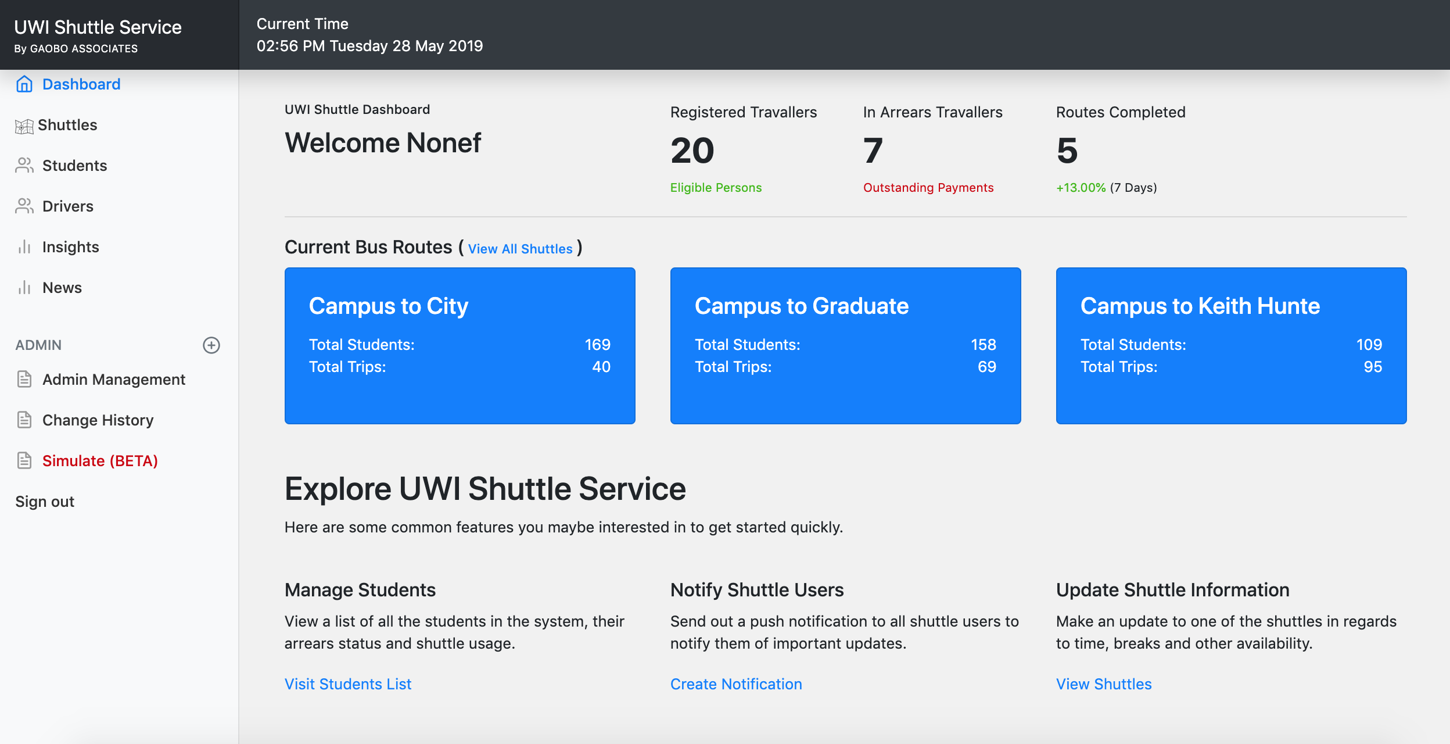

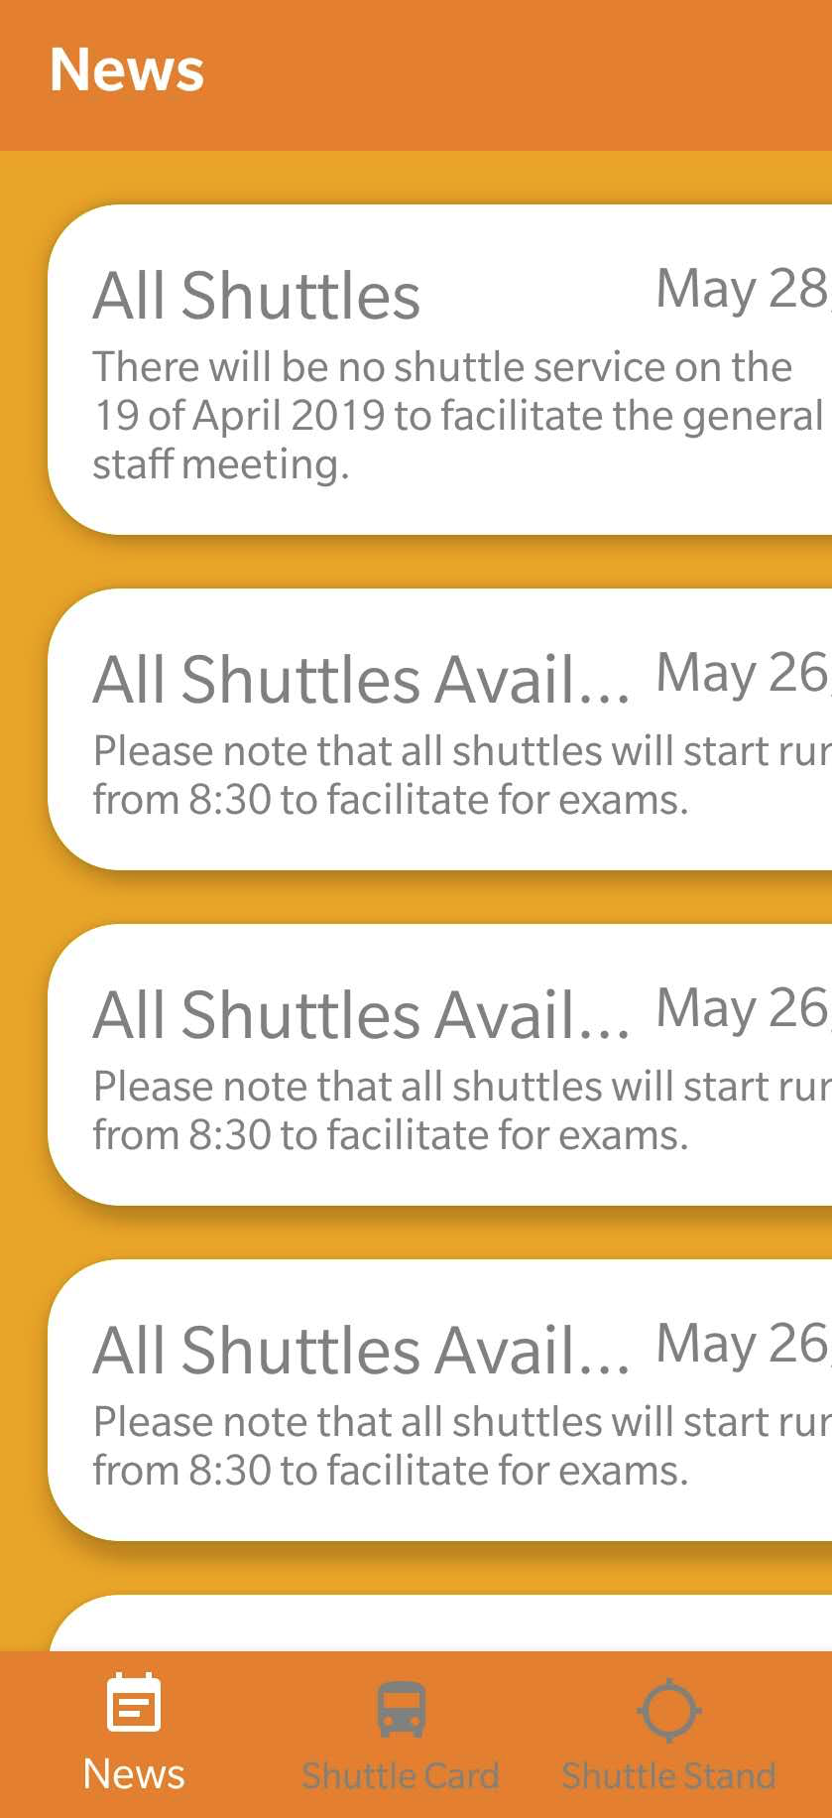
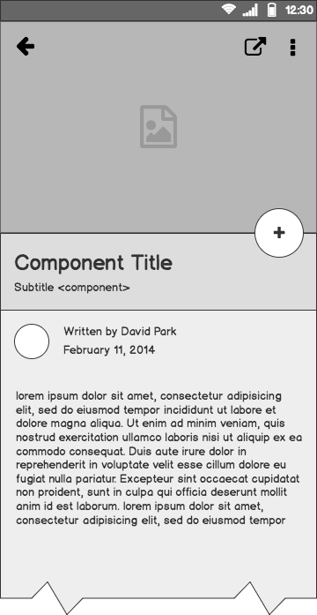
UWI Shuttle
Service Web Application
By NIRO Solutions

Slide 2
Outline
The Problem
Technology Tool set & Architecture
Application Walk Through
Next Steps
Questions ?

Slide 3
The Problem

Slide 4
What is the
Problem
The Current UWI Cave Hill Bus Service is Inefficient.
Students suffer from long delays of the shuttle.
They miss notifications about important updates.
The current system doesn’t provide any insights to improve the service for the students.

Slide 5
What students do currently
They complain, wait, wait, wait then wait some more until the bus appears.
Students are forced to seek other means of transportation. So the are basically paying double for one service.
Admin keeps a physical log of data but what really happens to this data besides storage? Nothing

Slide 6





Technology tool set & Architecture
FLASK AND MORE
FRONTEND
And 10+ packages
1
API
List of tools used to create the solution we have developed.
BACKEND

Slide 7
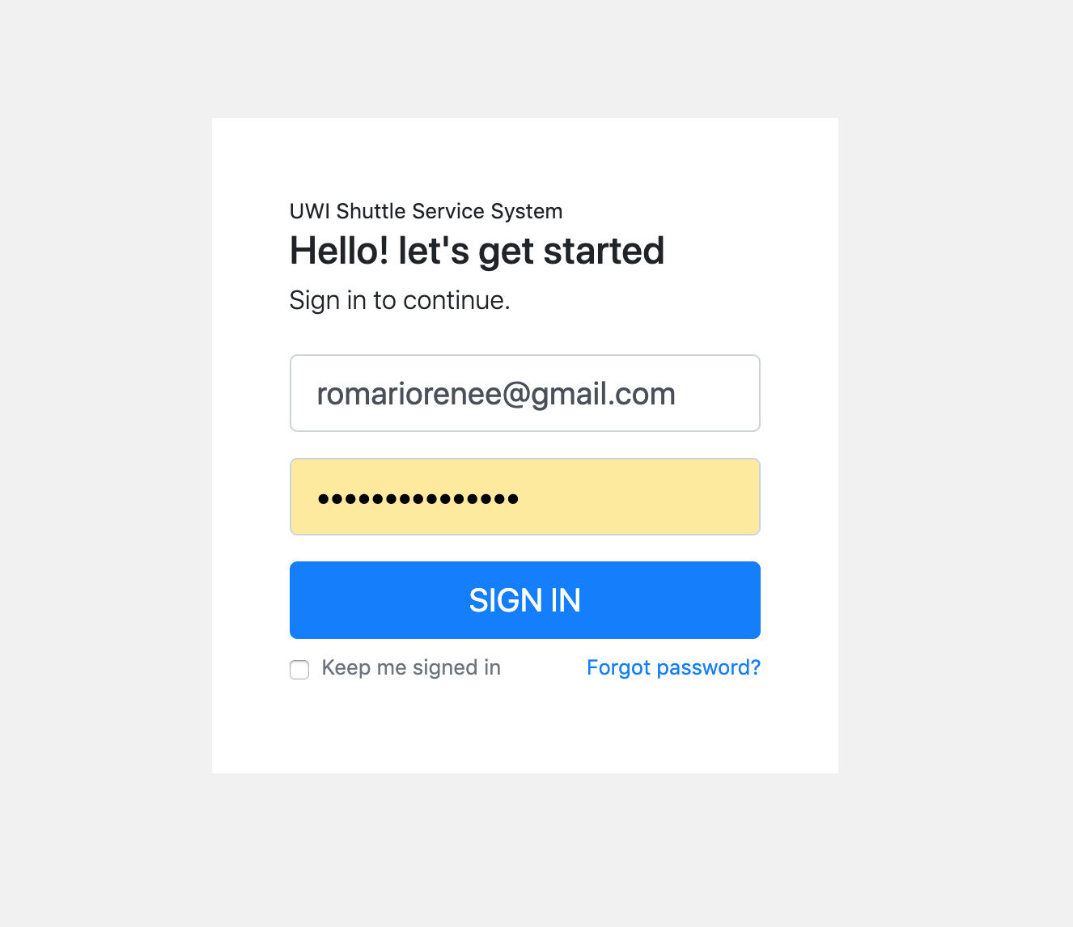
UWI Shuttle Application Manager
Dashboard
Shuttle Management
Students Management
Insights
News with Push Notifications & Google Translations

Slide 8
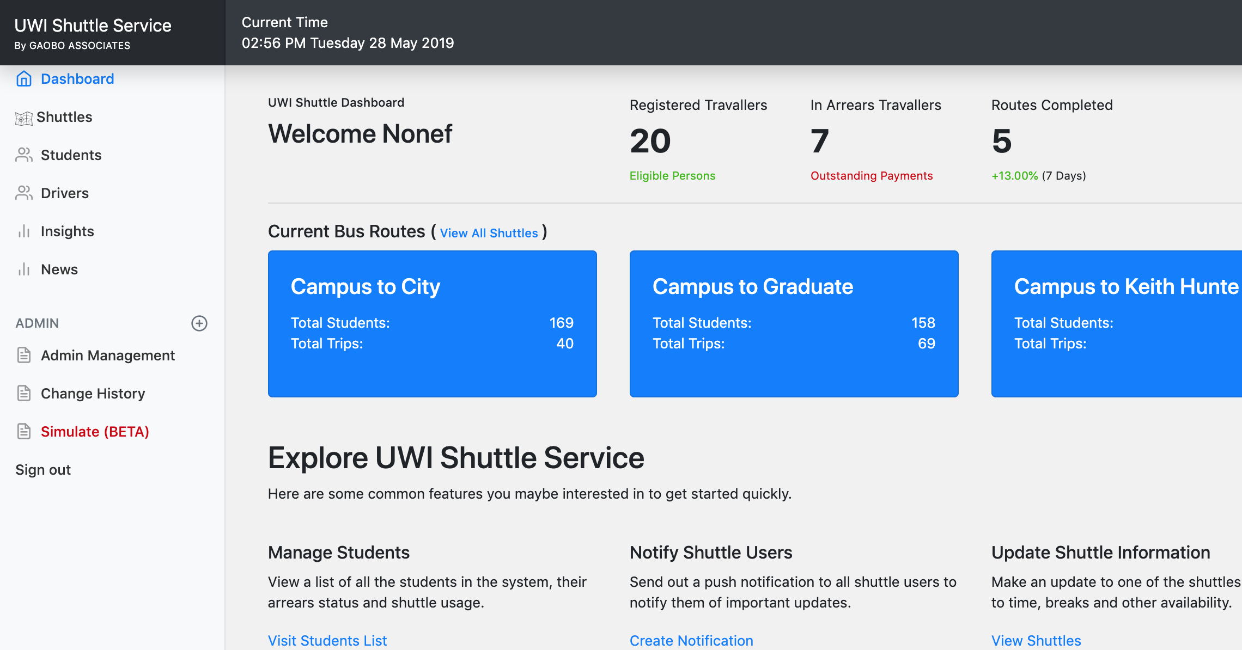
Dashboard
01
Student Statistics
Shuttle Quick Information
Quick Go To Options

Slide 9
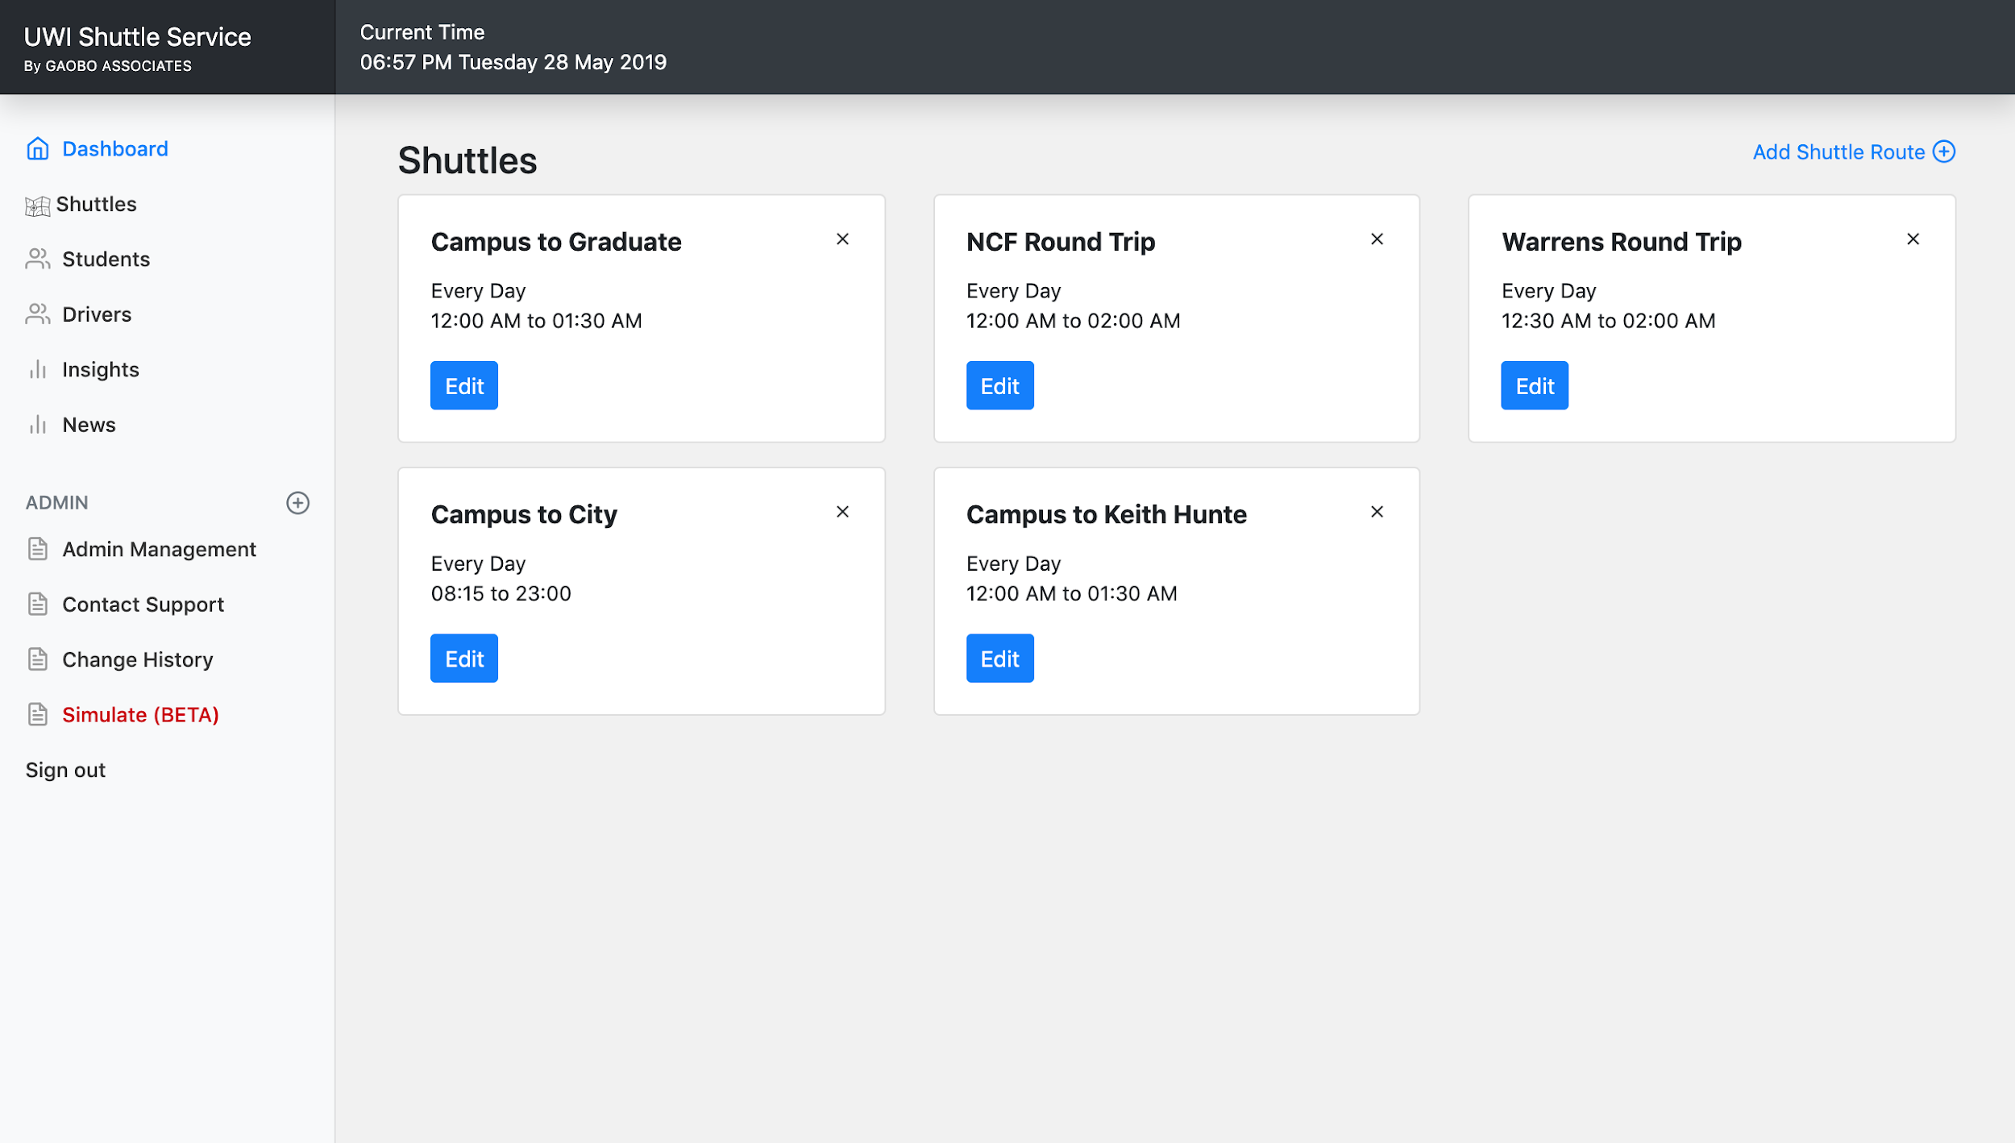
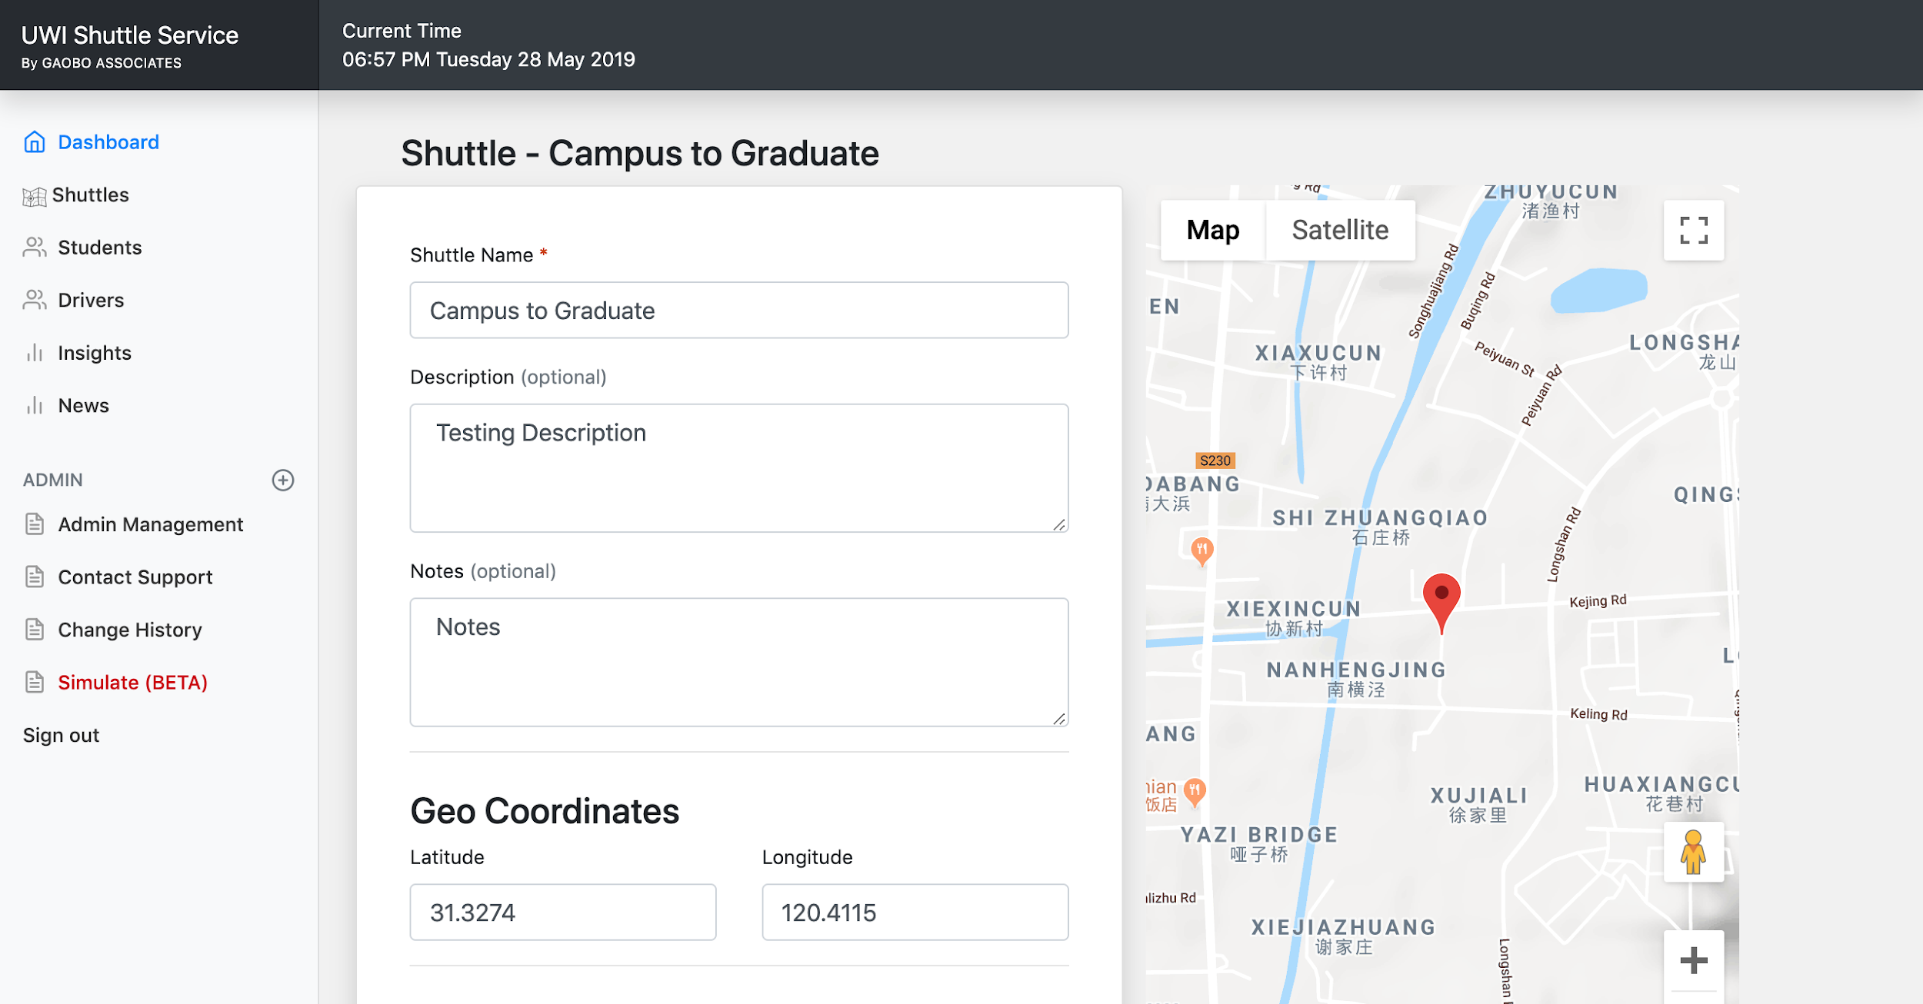
Shuttle Management
02
GET / POST Operations
User Sessions
Google Maps

Slide 10
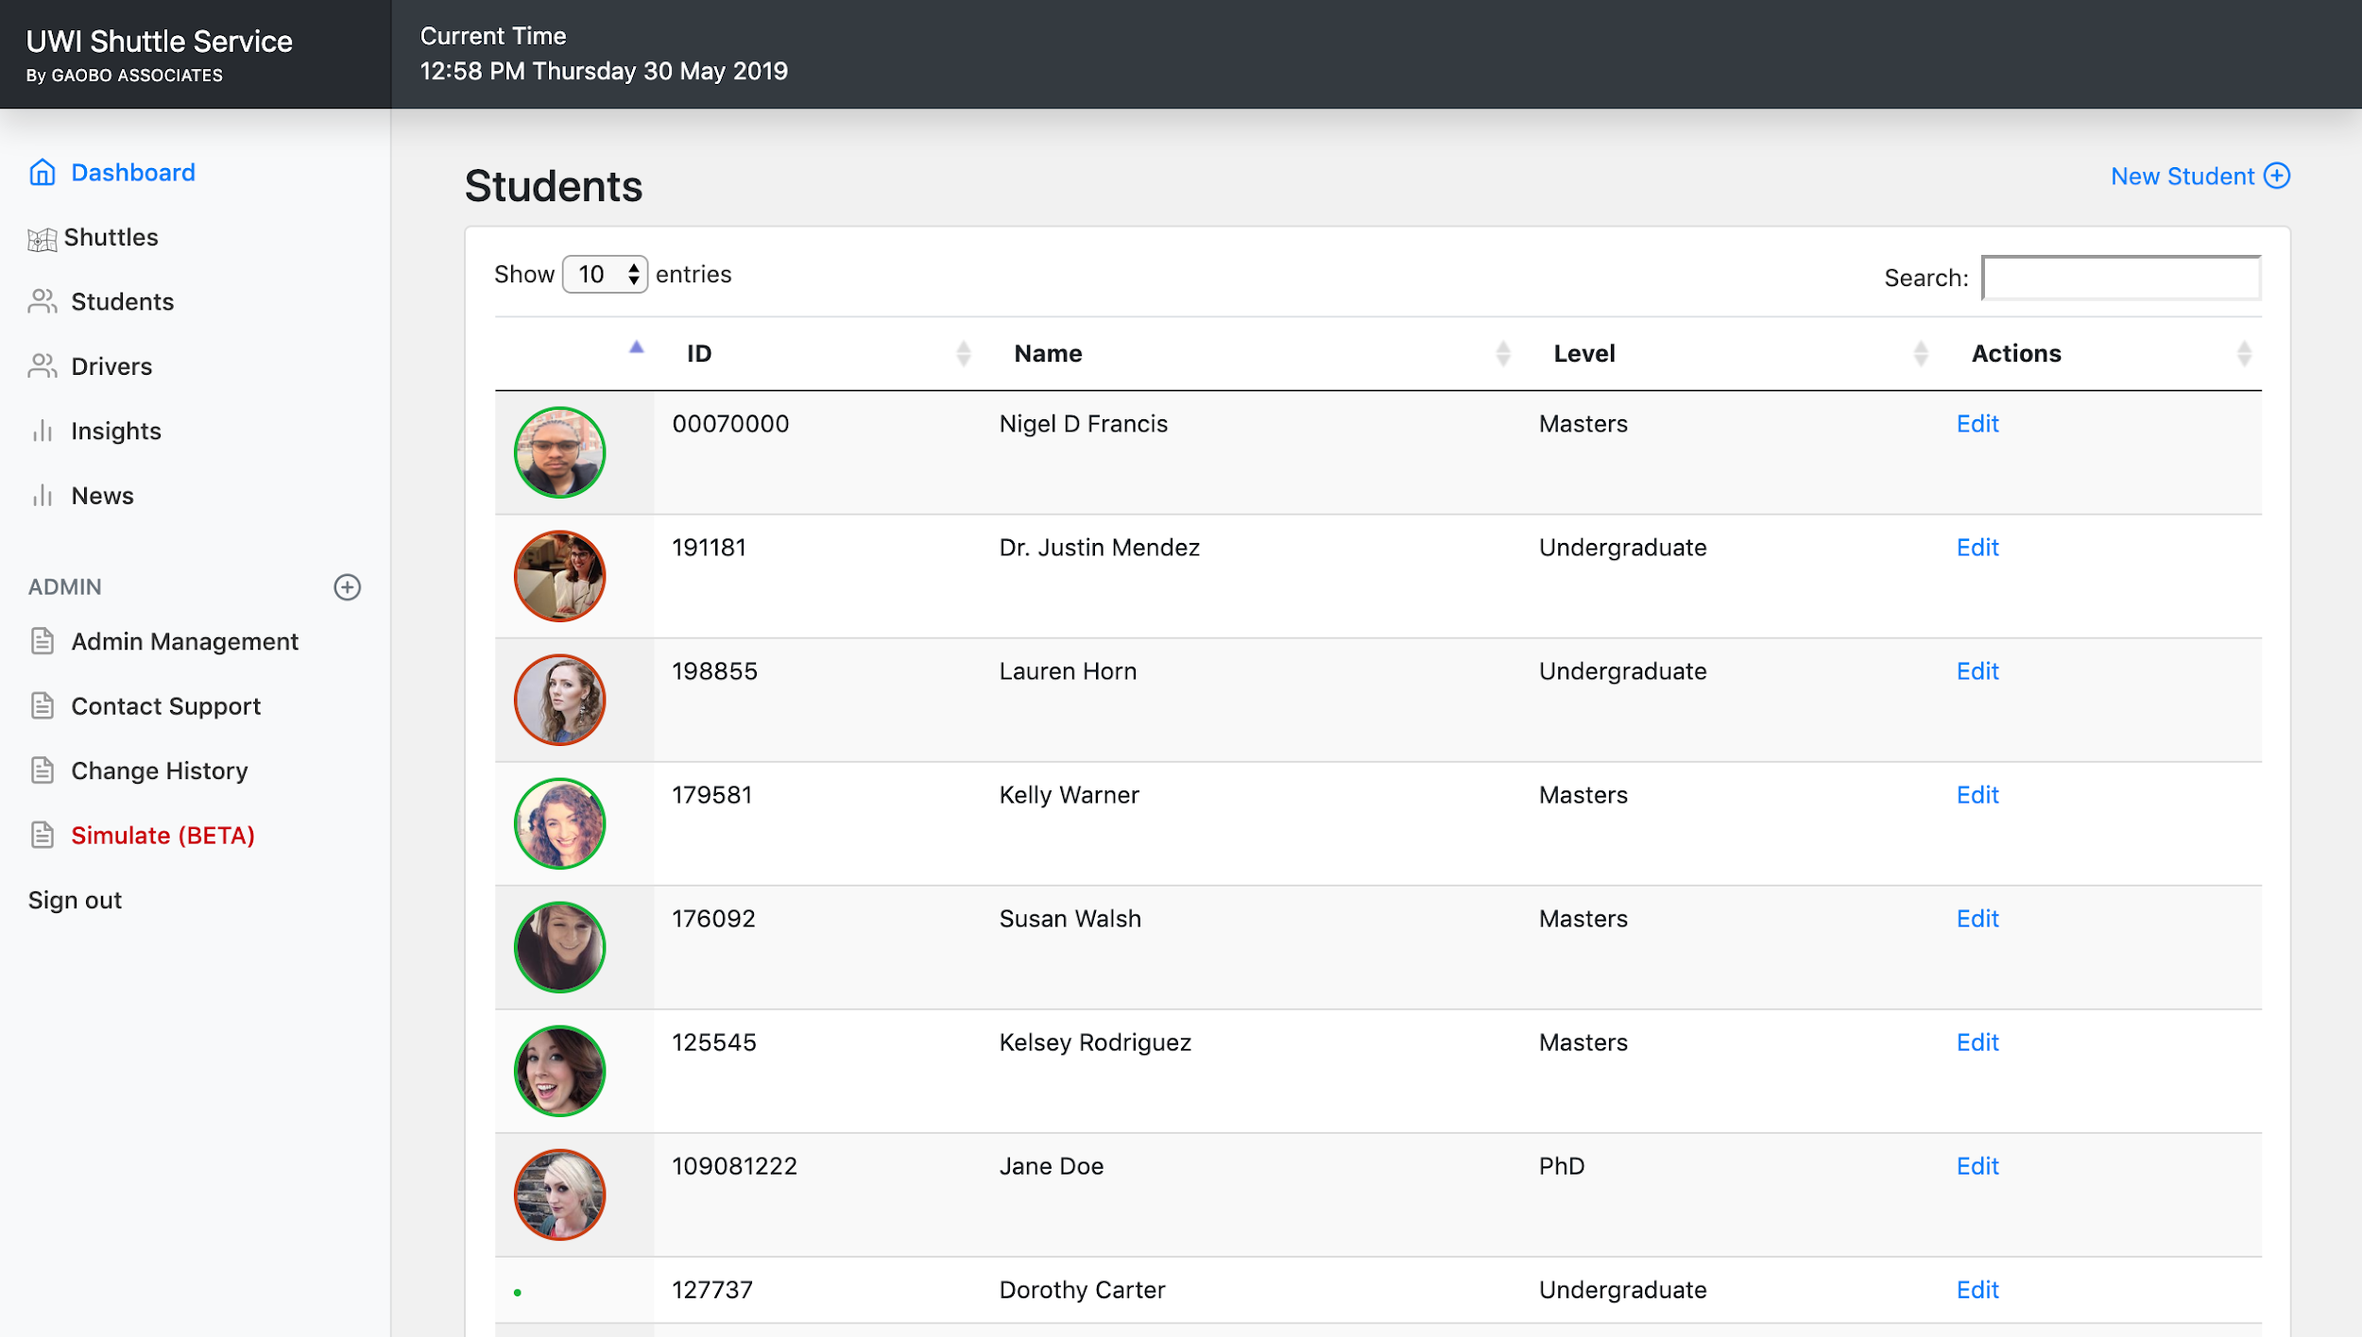
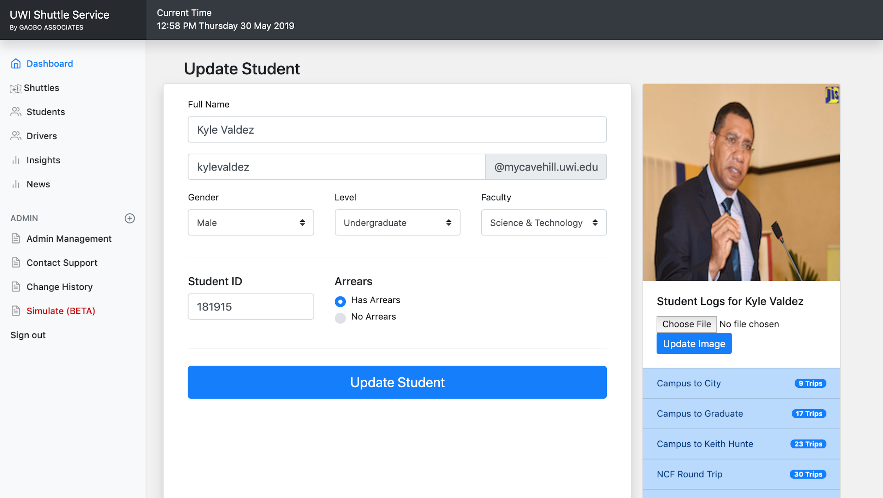
Student Management
03
The red and green circles represent outstanding fees.
Paginations
Quick Search
Student Profile & Trip Log
Image Uploads

Slide 11
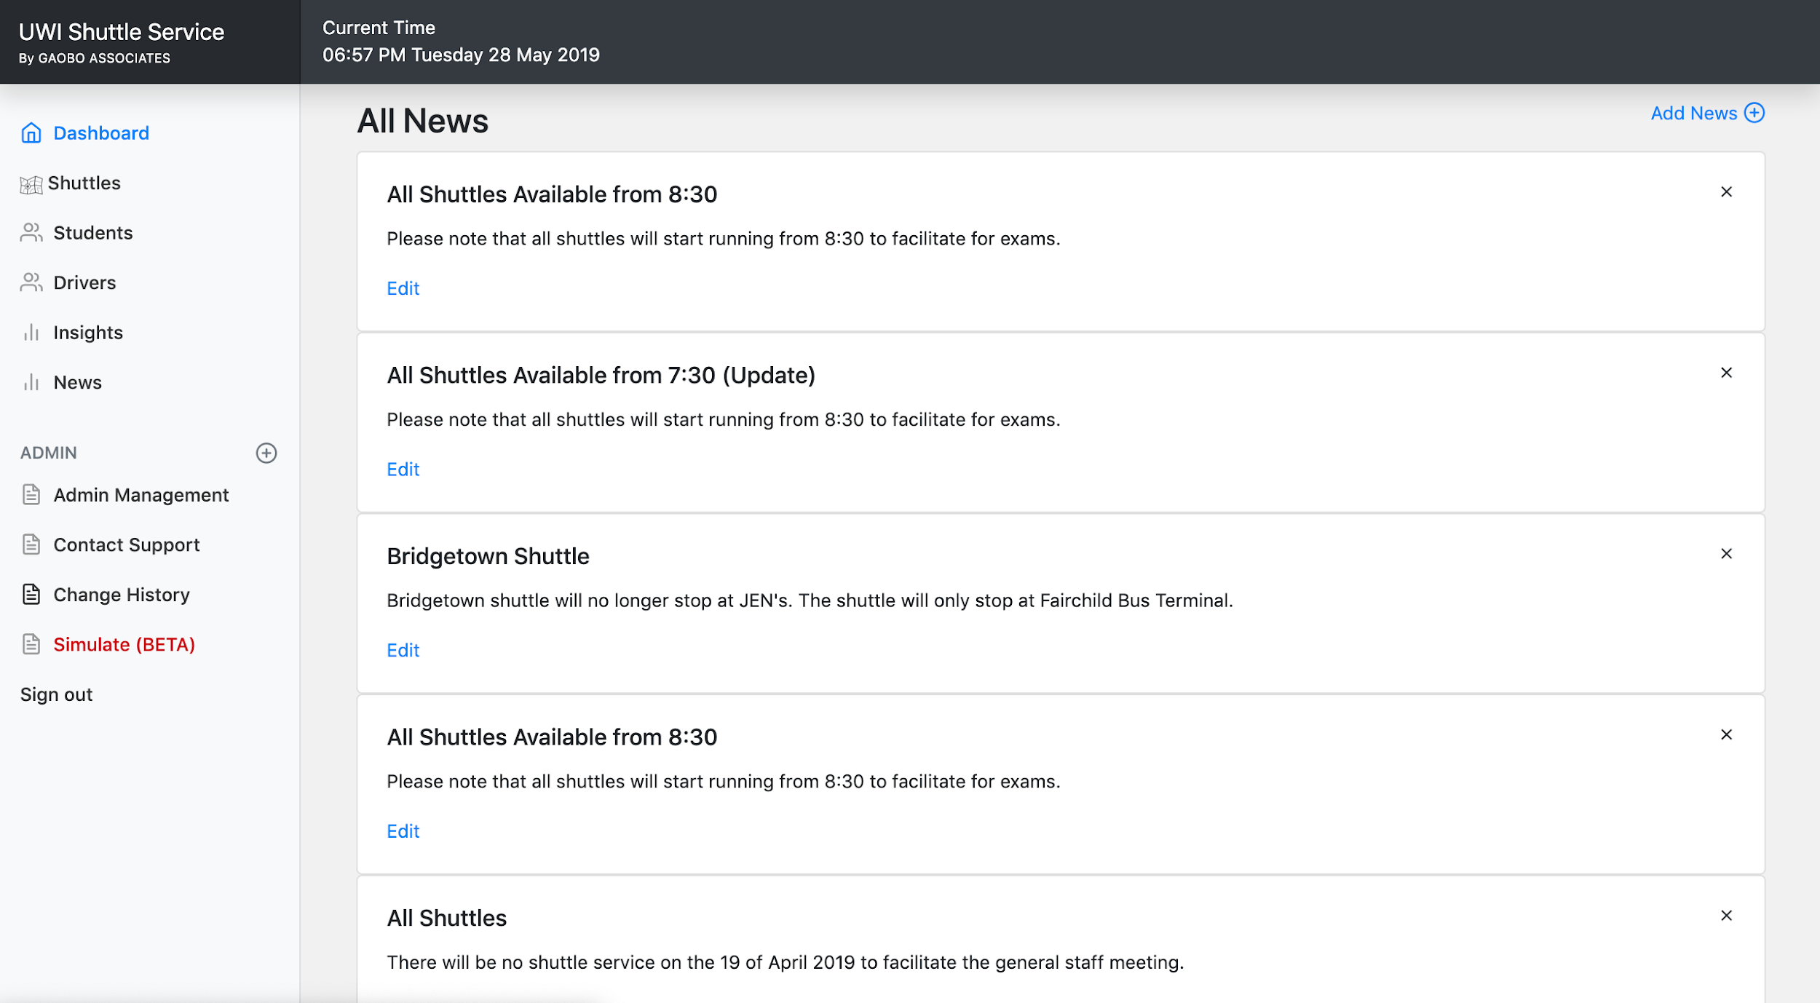
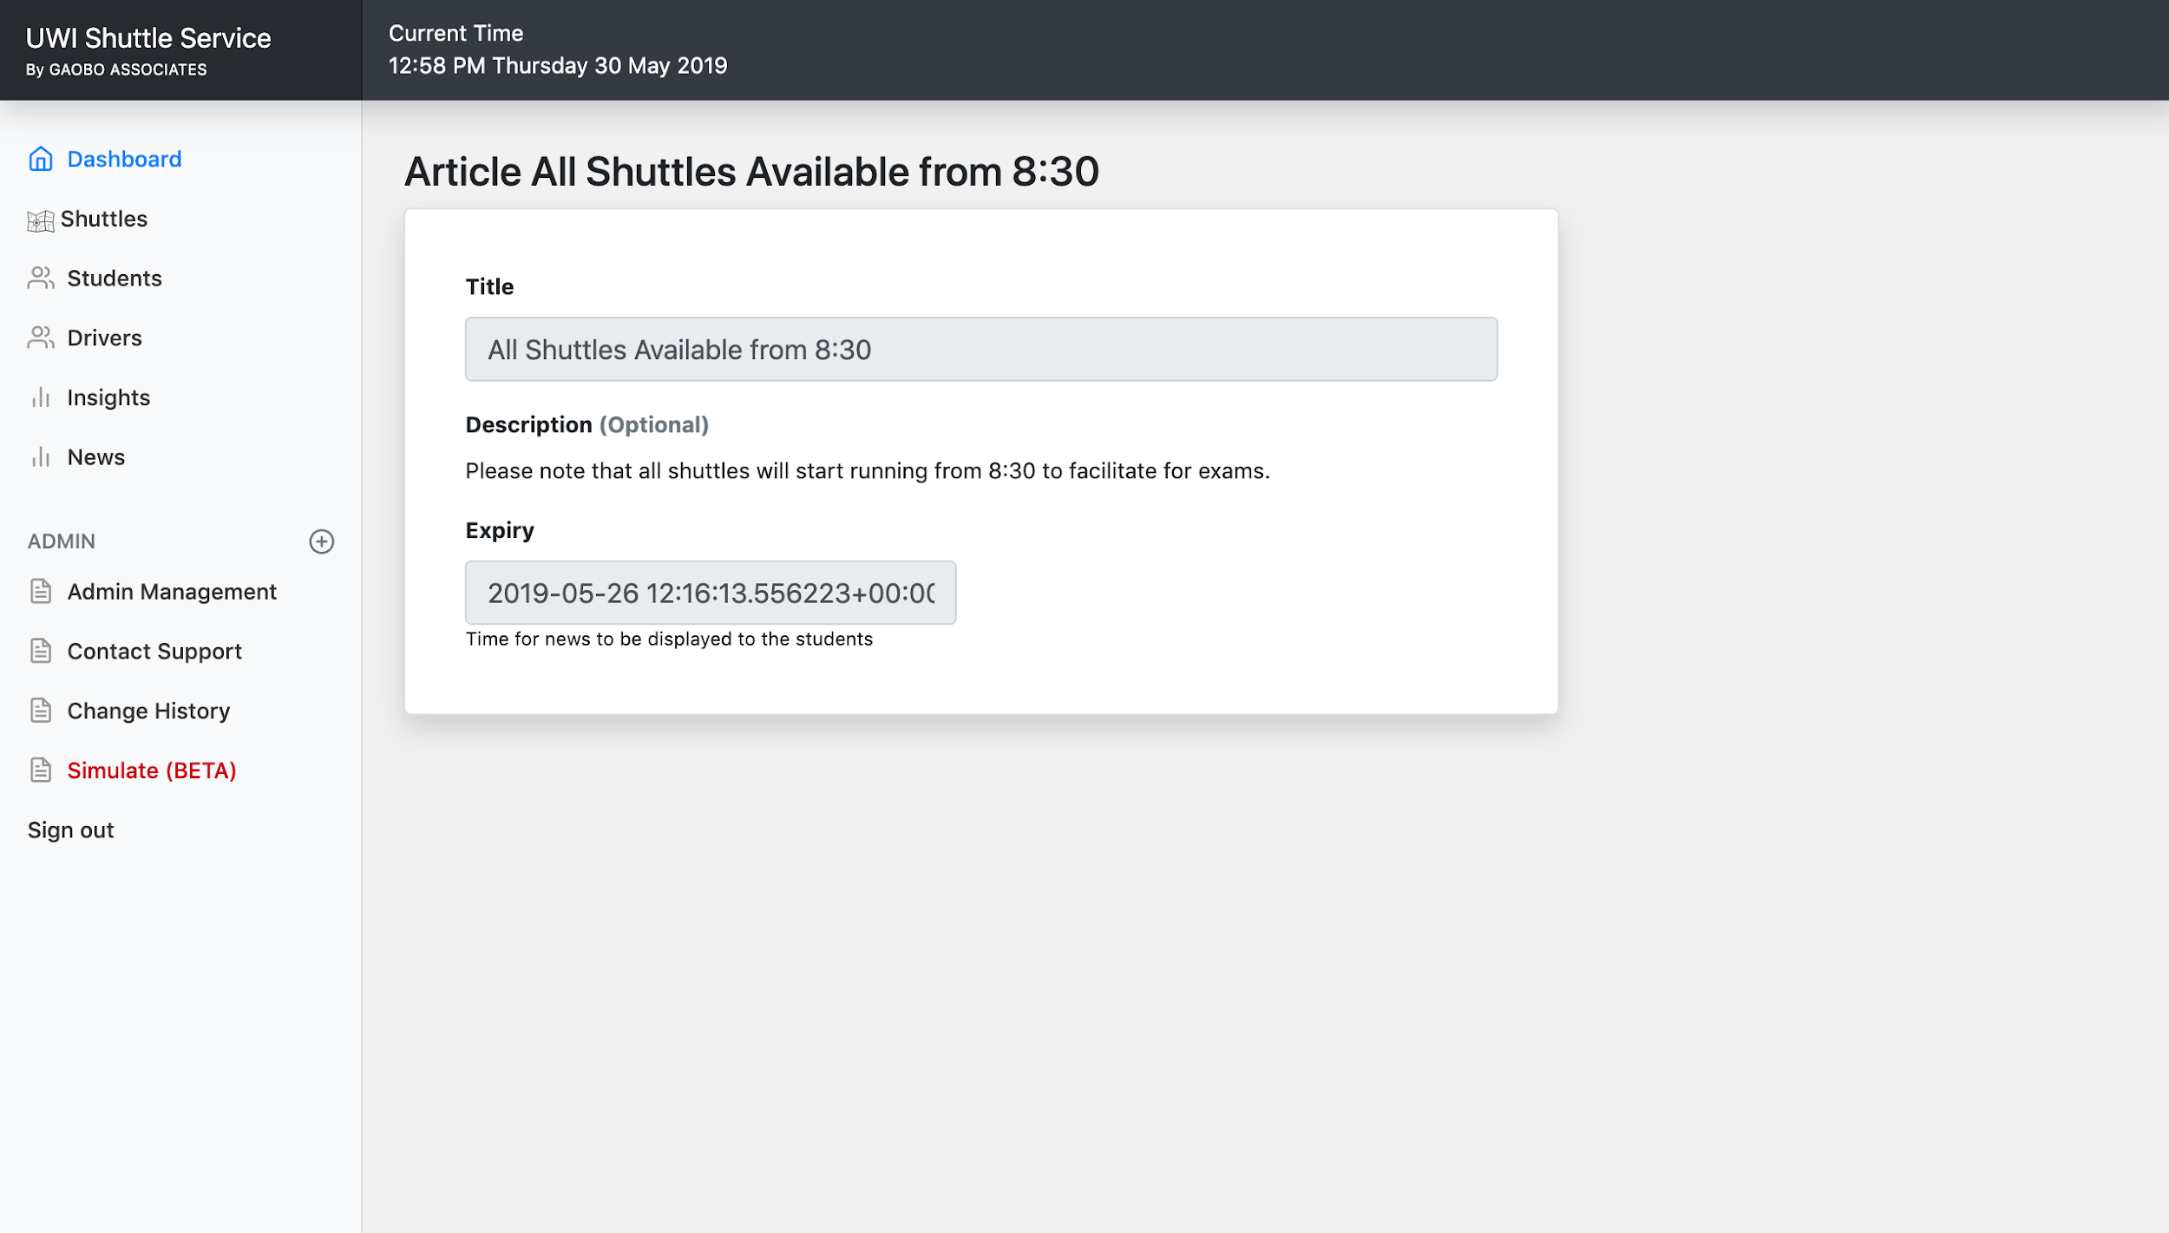
News & Push Notifications
04
Searching News Articles
Pushing to Student Devices
Google Translation Integration
Datepicker to handle expiry format

Slide 12
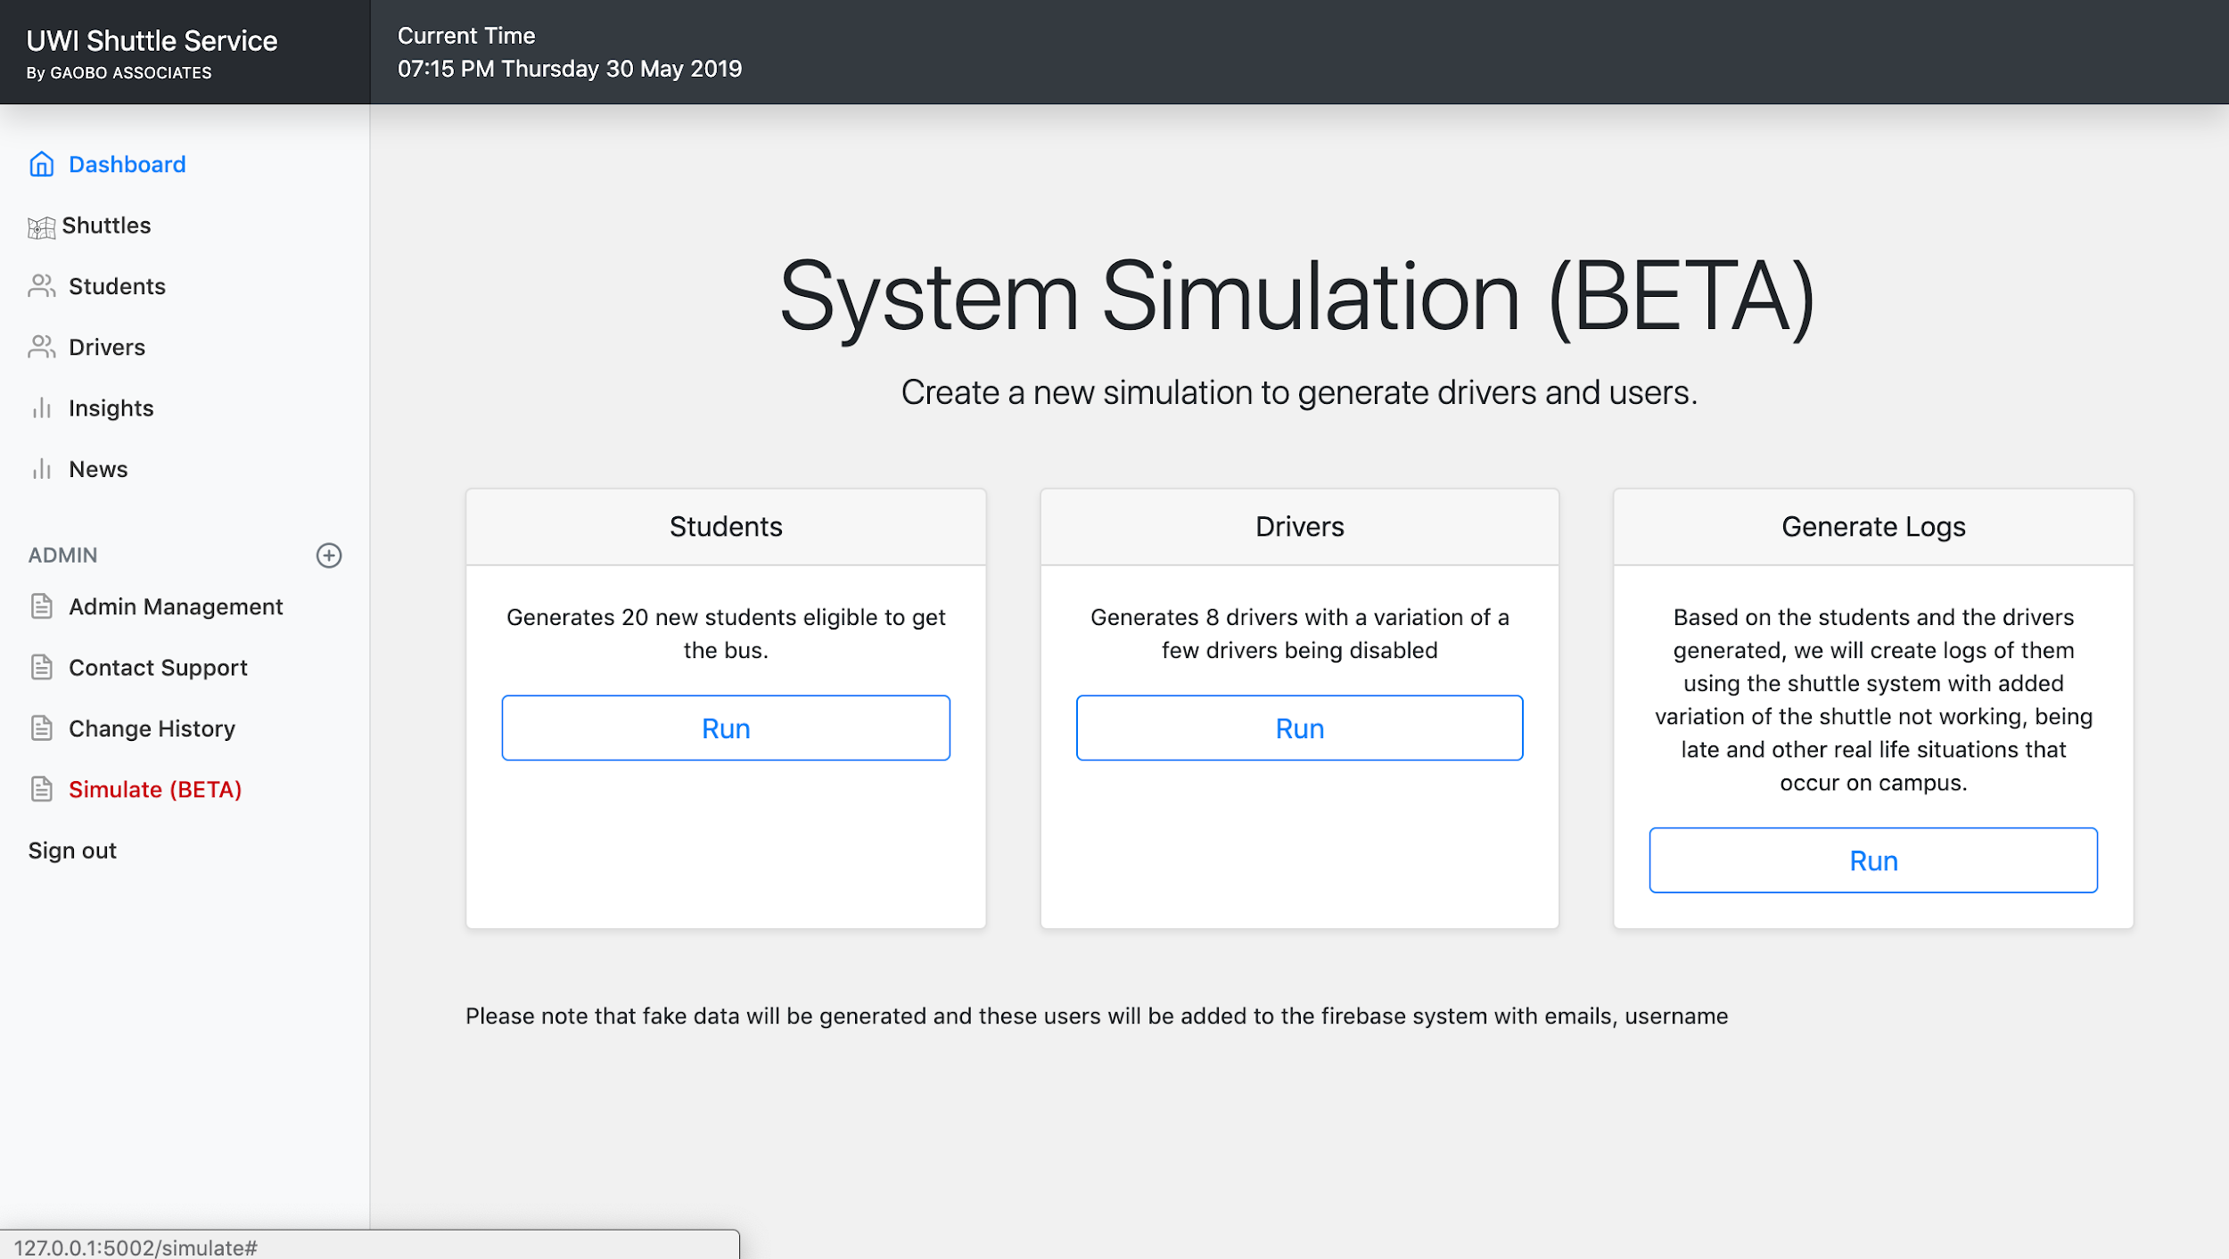
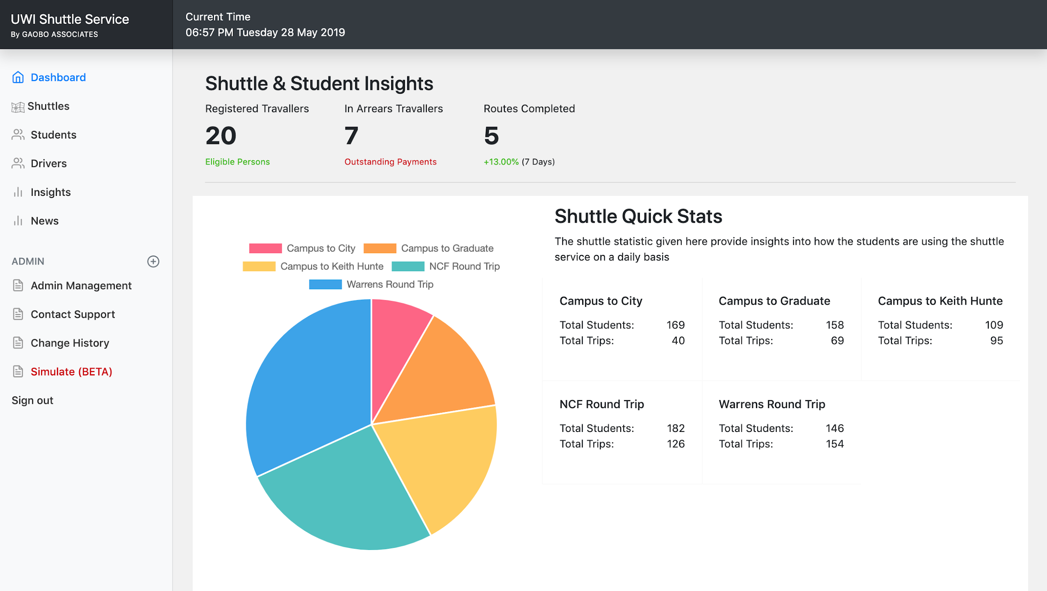
Insights
05
AJAX for Custom API & Chart JS
Details of the system data collected
Generating Data for the Chart

Slide 13
Application Demonstration
A complete walk through of the UWI
Service Application, what’s happening
in the background & how firebase
comes in play.

Slide 14
Next Steps

Slide 15
What next?
Going Online.
More advanced Insights and an improve Simulator
Access to the Translated News
More detailed Log History to monitor admin use
Improved notifications with Grouping by Faculty

Slide 16
Questions?

